Slide 1
The solar system
www.ecosystemforkids.com

Slide 2
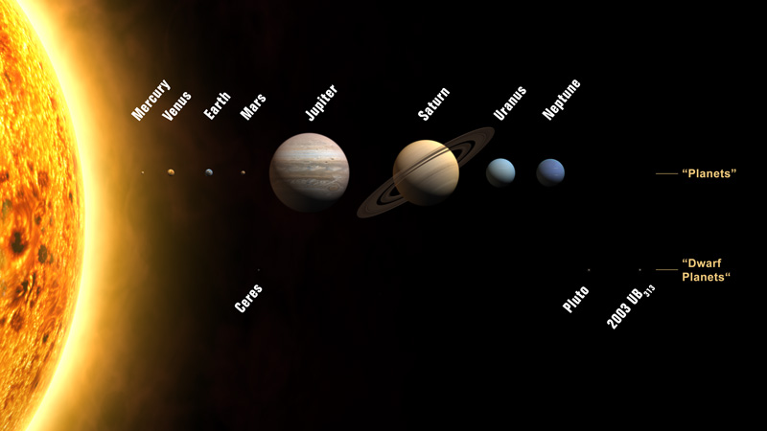
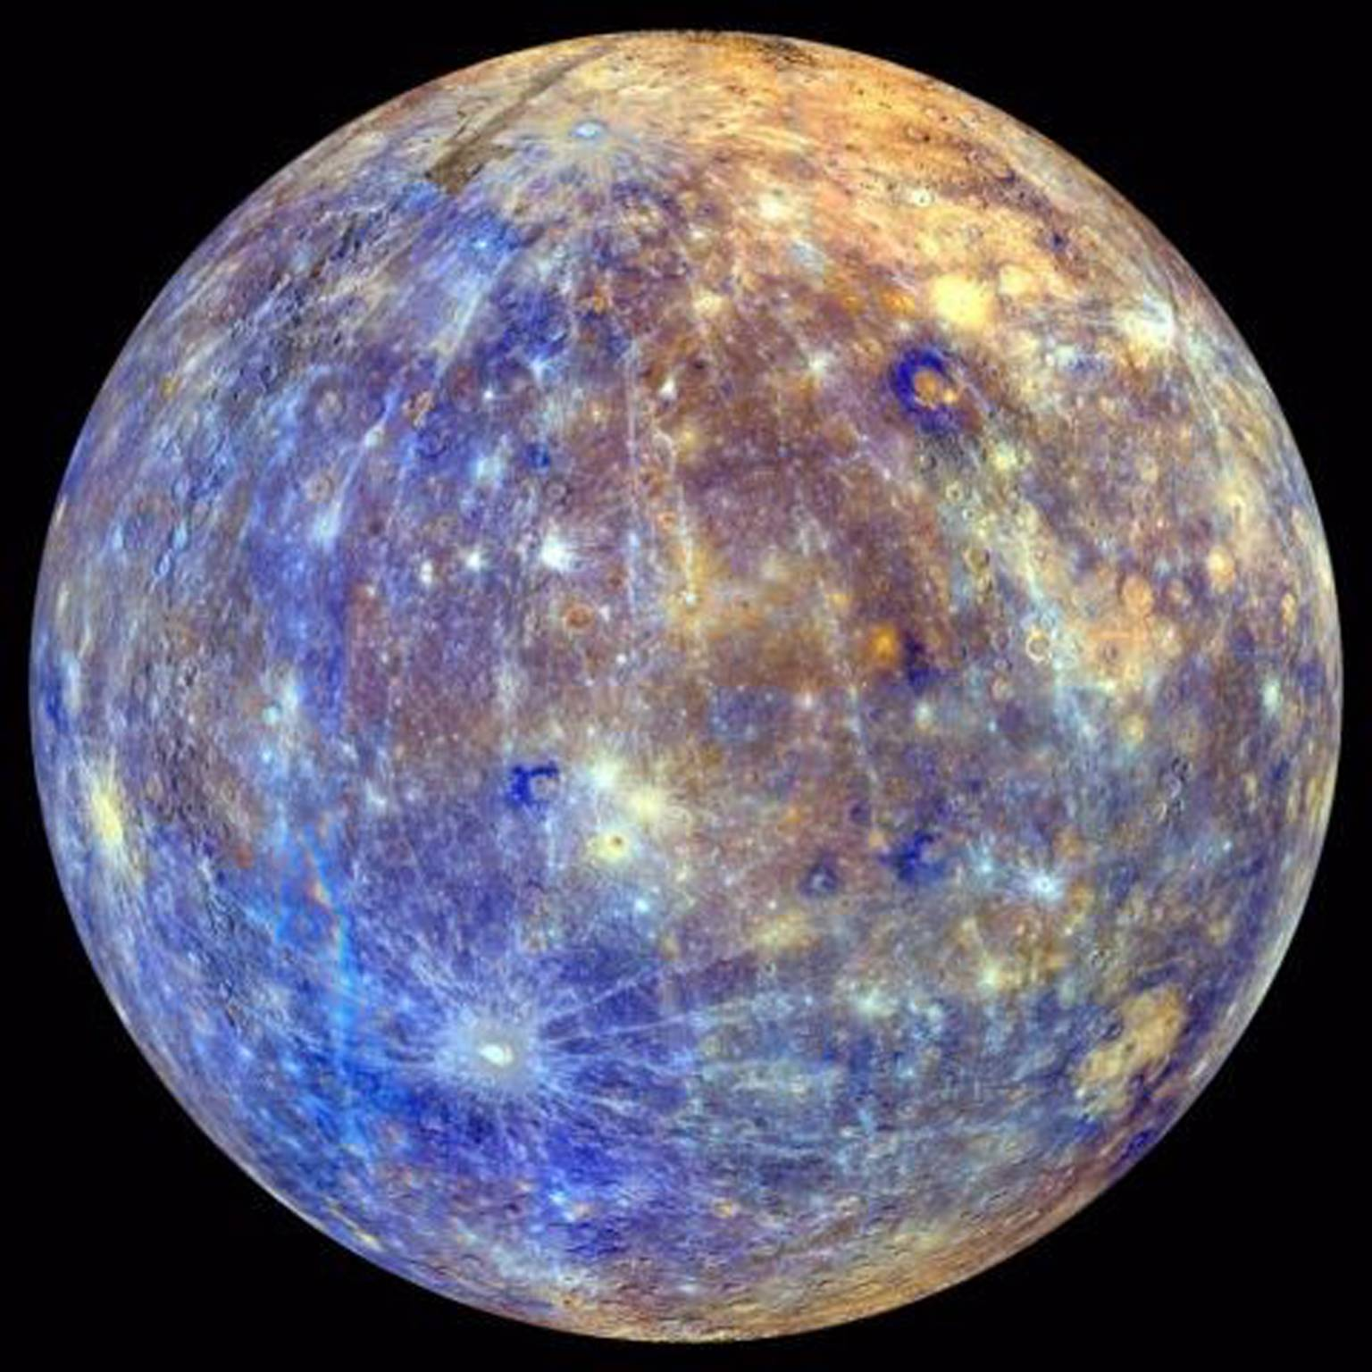
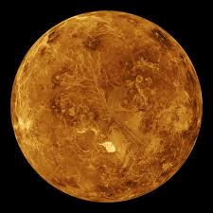
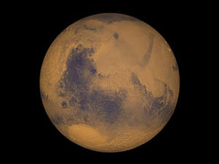
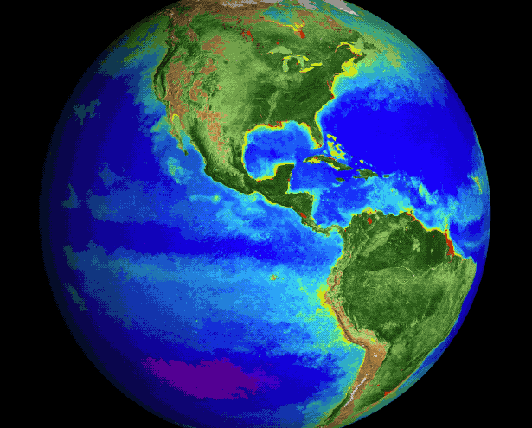
Mars: Mars is the fourth planet from the Sun and the second-smallest planet in the Solar System after Mercury.
Radius: 3,390 km
Mass: 6.39 × 10^23 kg
Distance from Sun: 227.9 million km
Neptune: Neptune is the eighth and farthest known planet from the Sun in the Solar System. In the Solar System, it is the fourth-largest planet by diameter, the third-most-massive planet, and the densest giant planet. Radius: 24,622 km
Distance from Sun: 4.495 billion km
Orbital period: 165 years
Mass: 1.024 × 10^26 kg
Surface area: 7.618 billion km²
Saturn: Saturn is the sixth planet from the Sun and the second-largest in the Solar System, after Jupiter. It is a gas giant with an average radius about nine times that of Earth. Radius: 58,232 km
Distance from Sun: 1.433 billion km
Mass: 5.683 × 10^26 kg)
Orbital period: 29 years
Surface area: 42.7 billion km²
Mercury: Mercury is the smallest and innermost planet in the Solar System. Its orbital period around the Sun of 87.97 days is the shortest of all the planets in the Solar System. Radius: 2,440 km
Distance from Sun: 57.91 million km
Mass: 3.285 × 10^23 kg
Surface area: 74.8 million km²
Length of day: 58d 15h 30m
Uranus: Uranus is the seventh planet from the Sun. It has the third-largest planetary radius and fourth-largest planetary mass in the Solar System. Radius: 25,362 km
Distance from Sun: 2.871 billion km
Mass: 8.681 × 10^25 kg
Orbital period: 84 years
Surface area: 8.083 billion km²
Venus: Venus is the second planet from the Sun, orbiting it every 224.7 Earth days. It has the longest rotation period of any planet in the Solar System and rotates in the opposite direction to most other planets. Radius: 6,052 km
Surface area: 460.2 million km²
Mass: 4.867 × 10^24 kg
Distance from Sun: 108.2 million km
Orbital period: 225 days
Earth: Earth is the third planet from the Sun and the only object in the Universe known to harbor life. According to radiometric dating and other sources of evidence, Earth formed over 4.5 billion years ago. Radius: 6,371 km
Mass: 5.972 × 10^24 kg
Age: 4.543 billion years
Distance from Sun: 149.6 million km
Jupiter: Jupiter is the fifth planet from the Sun and the largest in the Solar System. It is a giant planet with a mass one-thousandth that of the Sun, but two-and-a-half times that of all the other planets in the Solar System combined. Radius: 69,911 km
Mass: 1.898 × 10^27 kg (317.8 M⊕)
Distance from Sun: 778.5 million km
Orbital period: 12 years
Surface area: 61.42 billion km²

Slide 3
www.ecosystemforkids.com
FREE PowerPoint Lessons For Teachers:
www.ecosystemforkids.com
Images: https://spaceplace.nasa.gov

